Slide 1

Renegade planet
pitch presentation

Slide 2
Renegade Planet
Our Game
Our partners
Why our game?
Art and Inspiration

Slide 3
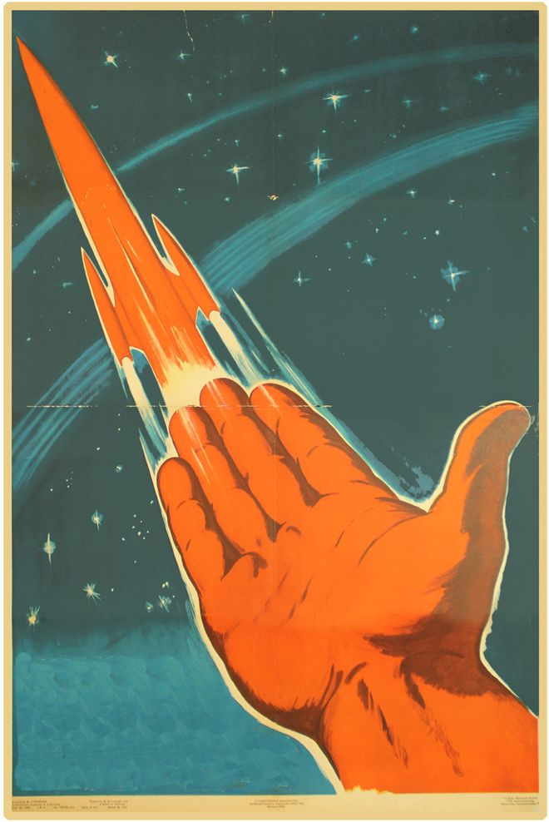



Slide 4
OUR PARTNERS
PlayStation
Why PlayStation?
History of supporting developers
Excellent first party community
Stable platform
Get behind unique and weird games

Slide 5
WHY OUR GAME
Unique perspective
Being social
Exploration
Movement and Combat
Figure 8 loop
Local story
Strong Aesthetic

Slide 6
Why our team?
Strong developers
Local writers, writing a local story
Experienced artists and musicians

Slide 7
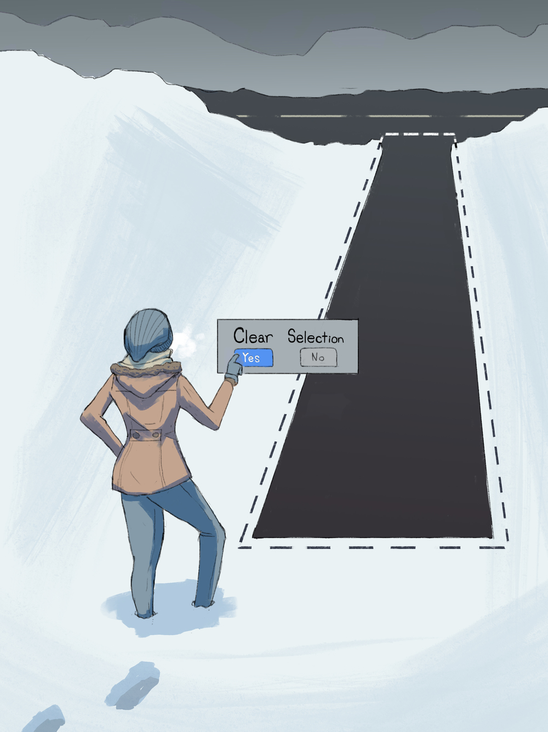
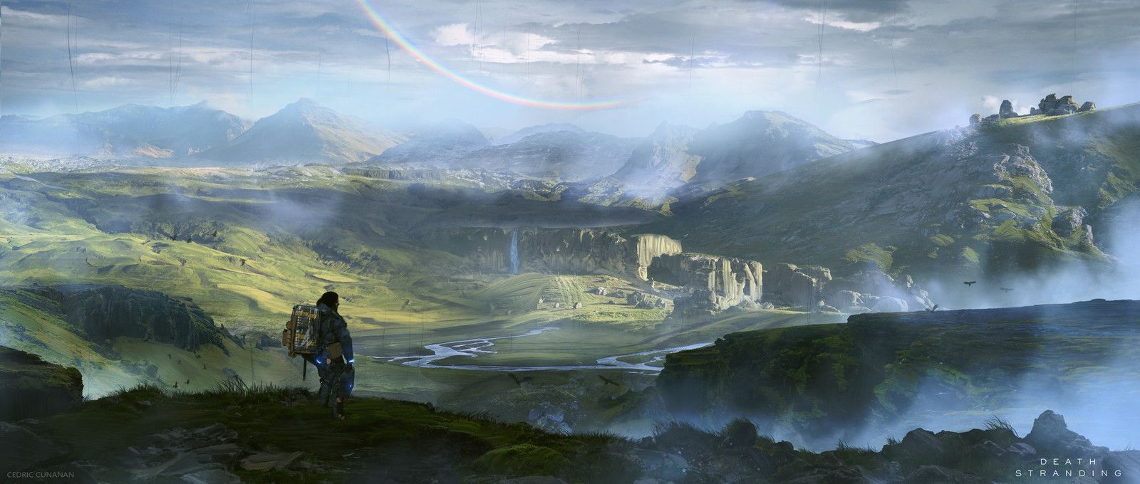
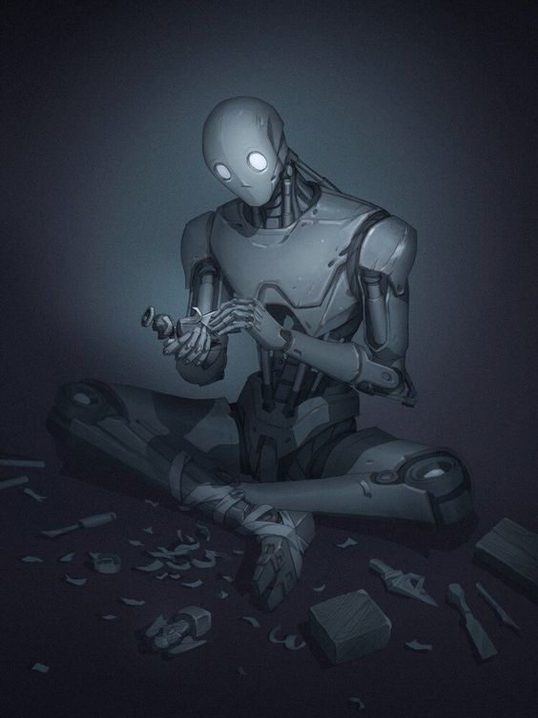
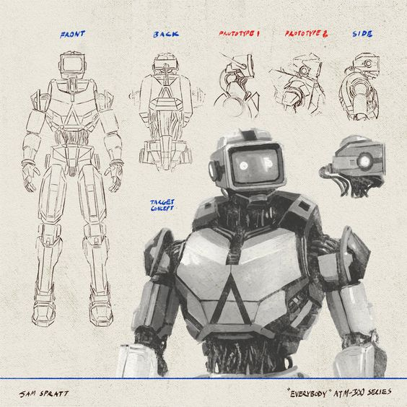
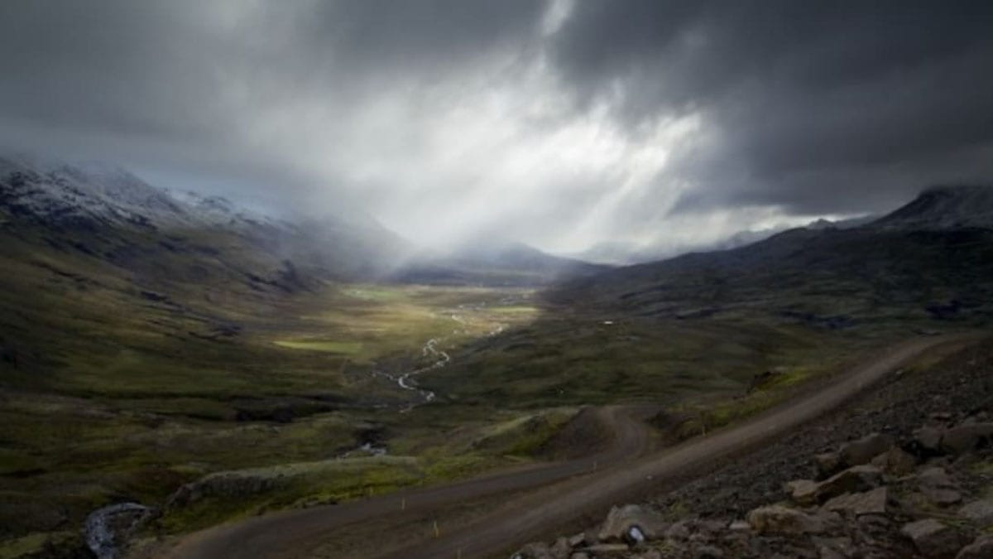
ART AND INSPIRATION

